Slide 1
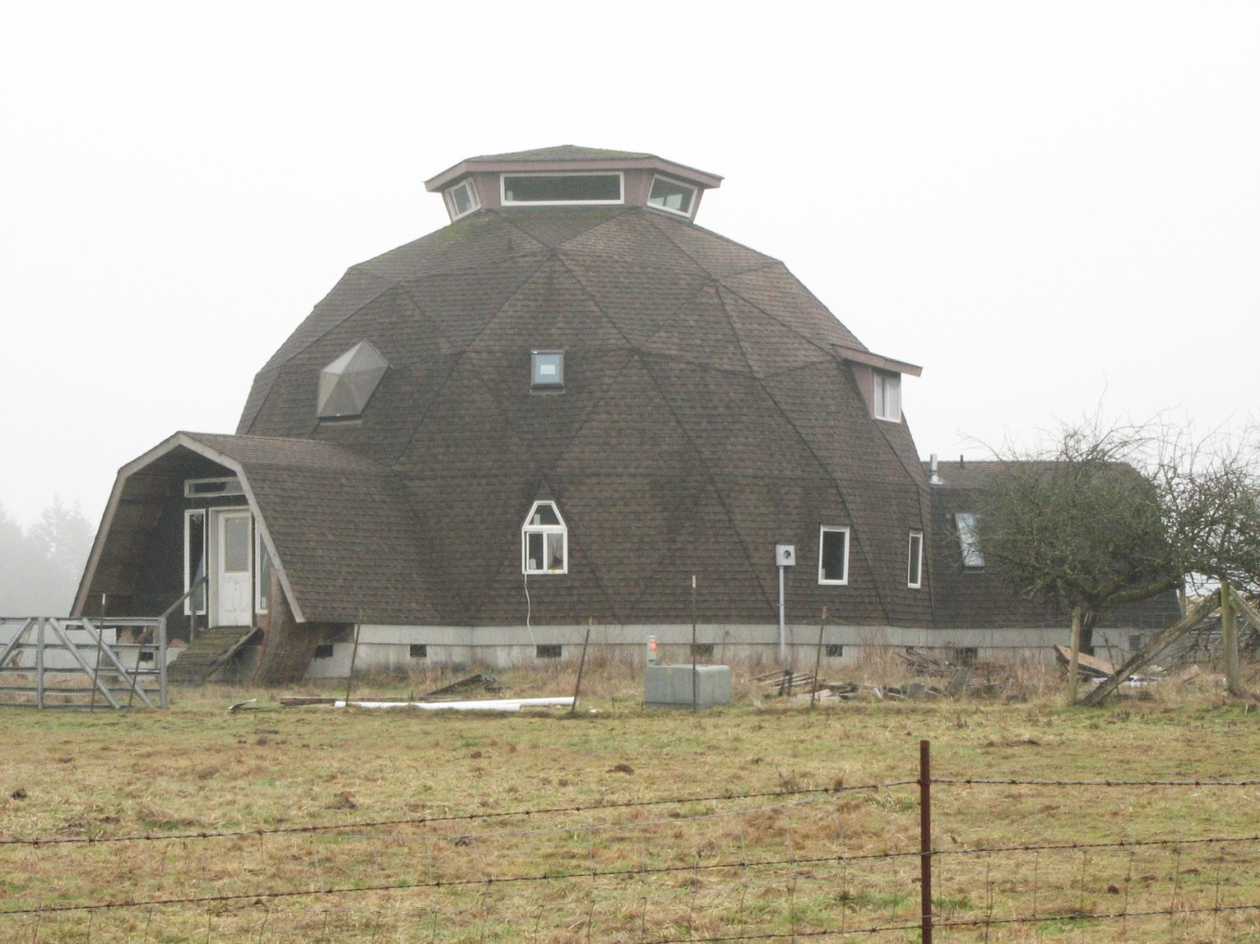
GEODESIC DOME
1960-Present
Space frame roof comprised of triangular-shaped panels
Copulas often found at peak of roof
Structure is composed of wood or metal frame
Skylights and dormer windows typical
Gambrel and flat roof wings often added as entry
Asphalt or cedar shingles, metal, plastic, and fiberglass cover plywood panels
Sliding glass entry doors are common
House Thurston County, c.1975
Concrete Foundation

Slide 2
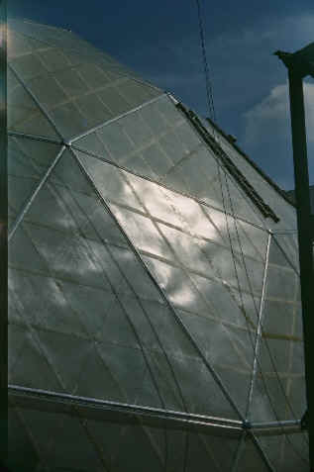
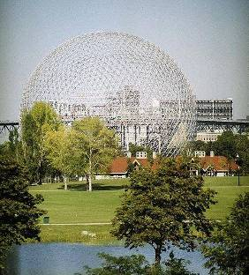
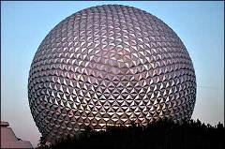
GEODESIC DOME
History
Ford Rotunda Dome Buckminster Fuller, Detroit , Michigan, 1953
Epcot Center Buckminster Fuller, Orlando, Florida, 1967
US Pavilion at Expo '67 Buckminster Fuller, Montreal, Canada, 1967
CatherDome Book 2, 1971
Seattle Times, April 5,1970
Dome Book 2, 1971

Slide 3
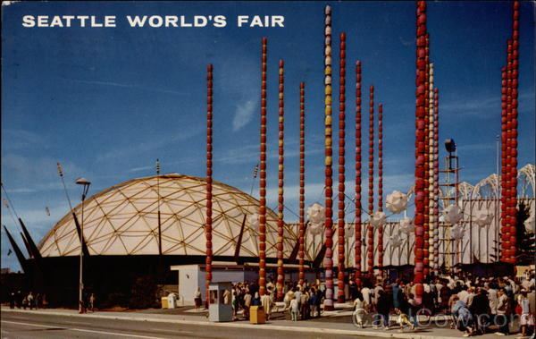
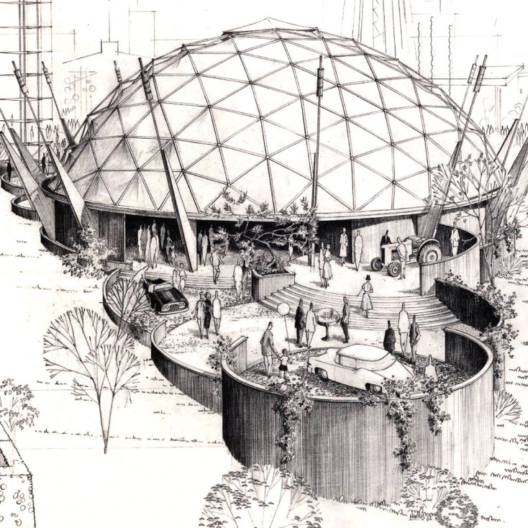
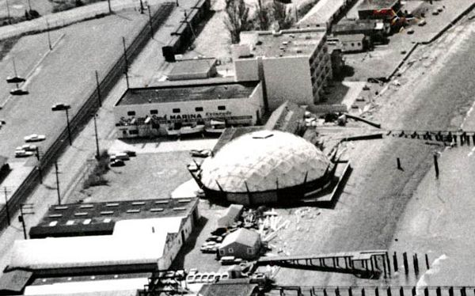
GEODESIC DOME
History
Ford Pavilion – Century 21 Expo
Architect/Engineer, TC Howard 1961
Sand and Surf Marina, Edmonds, 1963

Slide 4
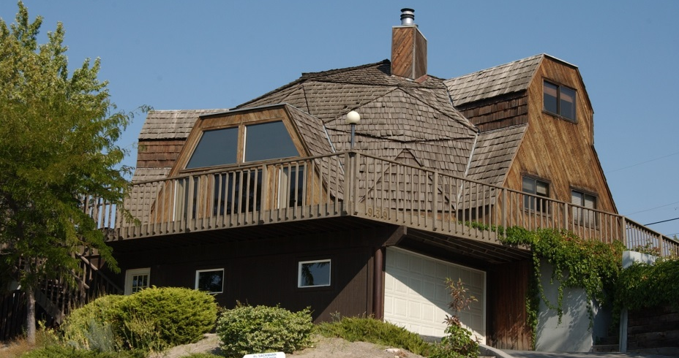
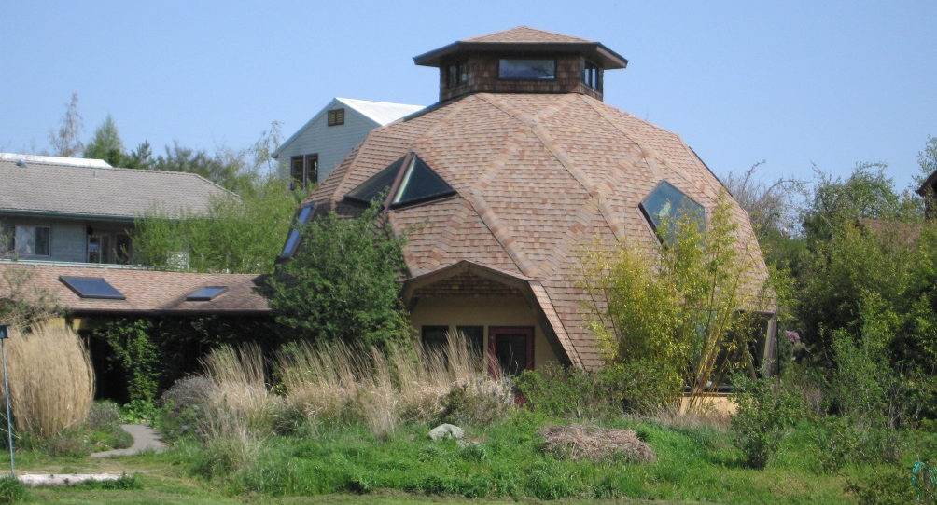
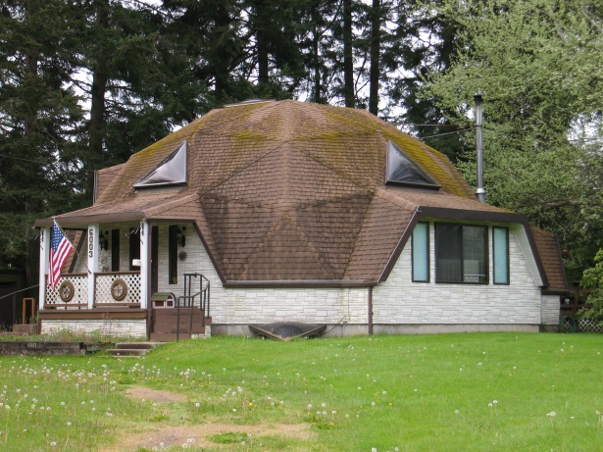
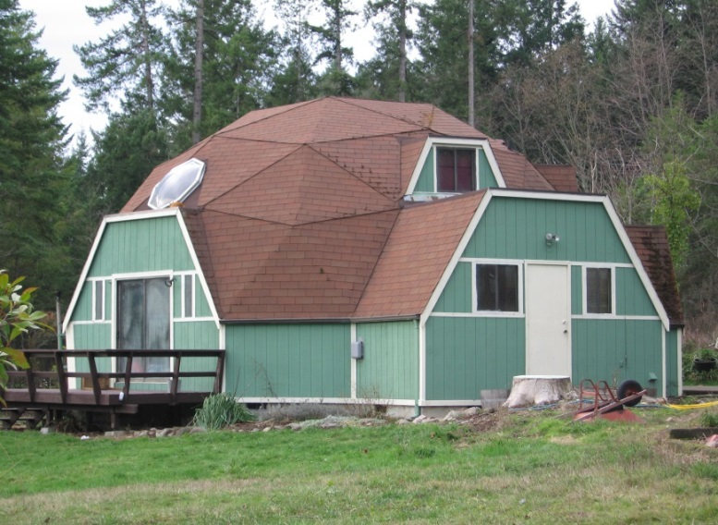
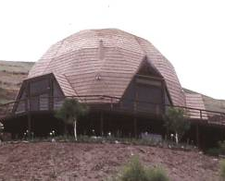
GEODESIC DOME
Residential Examples
House Moses Lake, c.1982
House Port Townsend, c.1967
House Lacey, c.1982
House Clarkston, c.1970
House Eatonville, c.1980

Slide 5
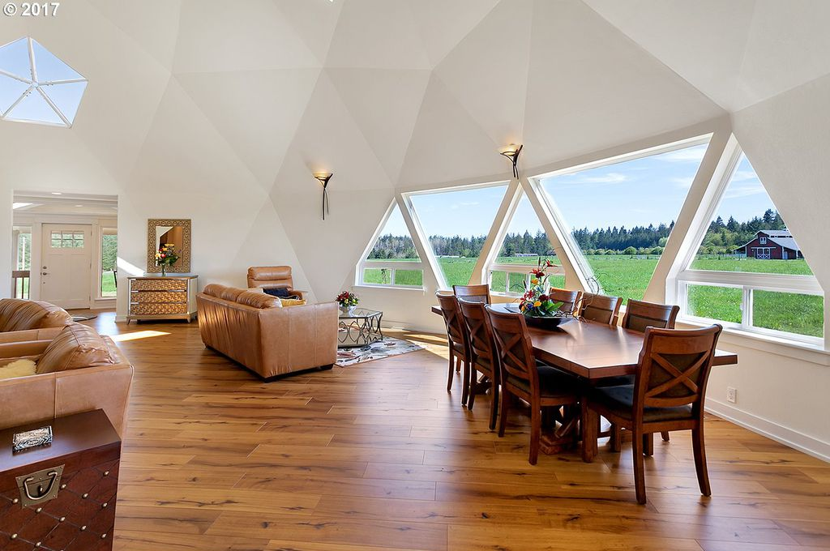
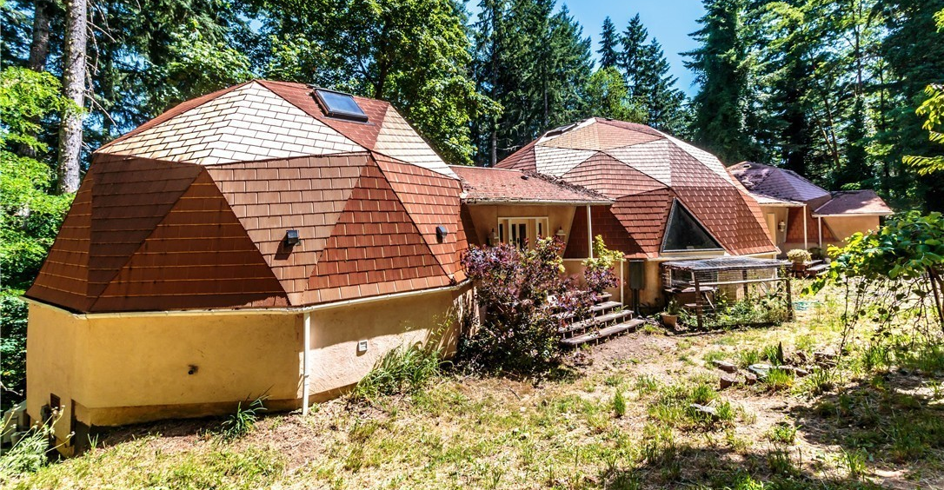
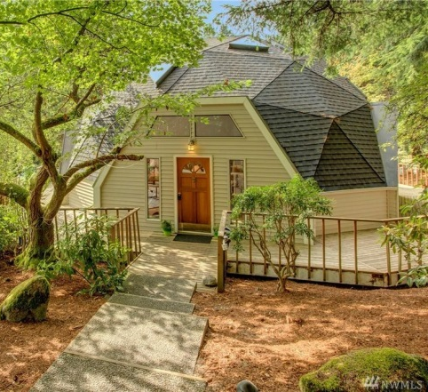
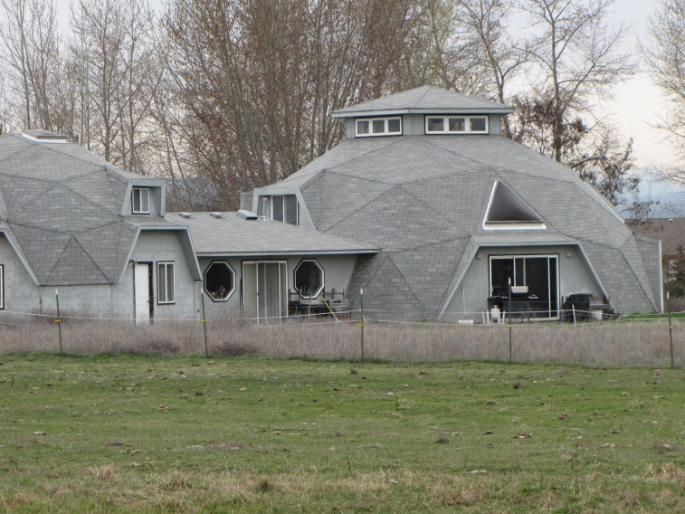
GEODESIC DOME
Residential Examples
House Friday Harbor, c.1982
House Shelton, c.1970
House Woodinville, c.1967
House Gig Harbor, c.1982
House Ellensburg, c.1980

Slide 6
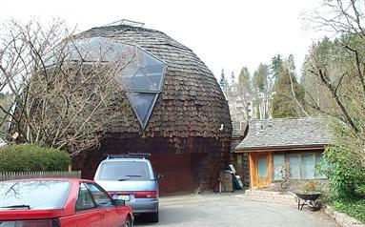
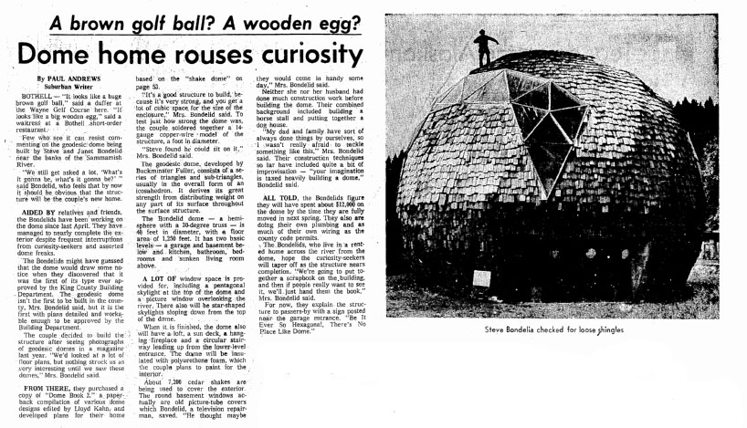
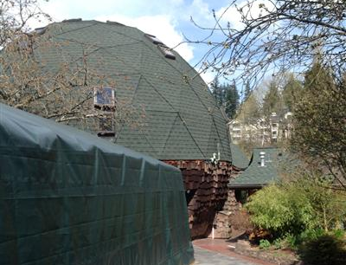
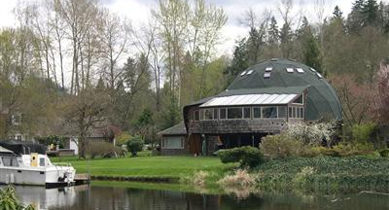
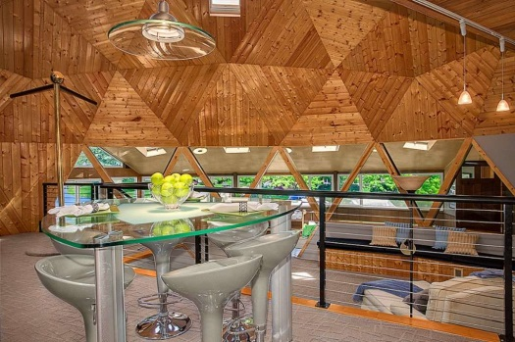
GEODESIC DOME
1st of its kind approved by King County Building Department
Steve & Janet Bondelid House
8656 ne 170th St, Bothell, 1974

Slide 7
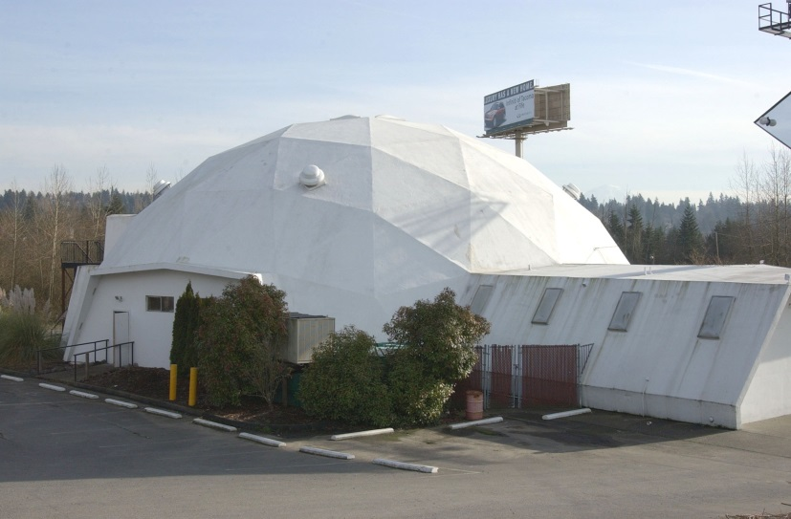
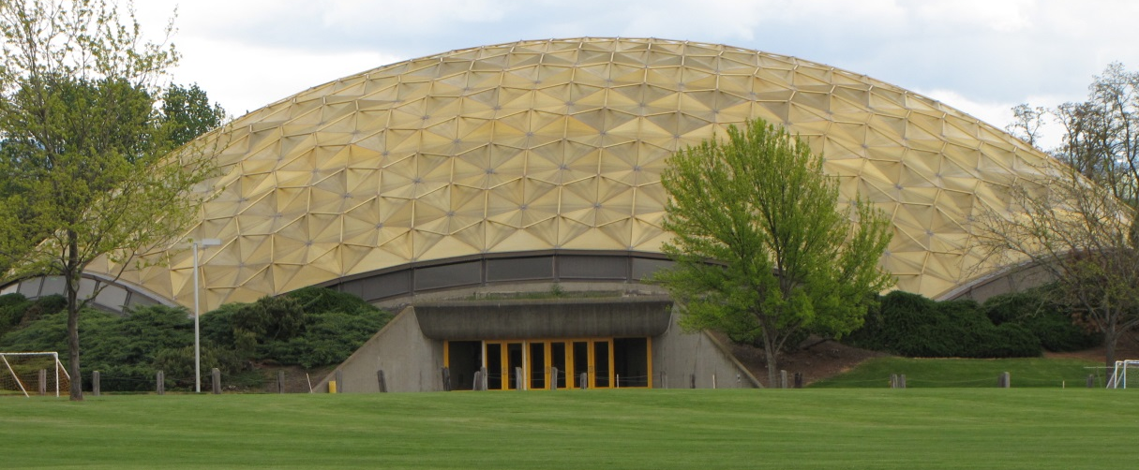
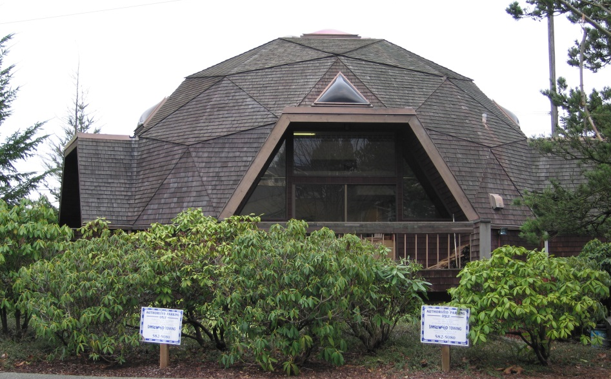
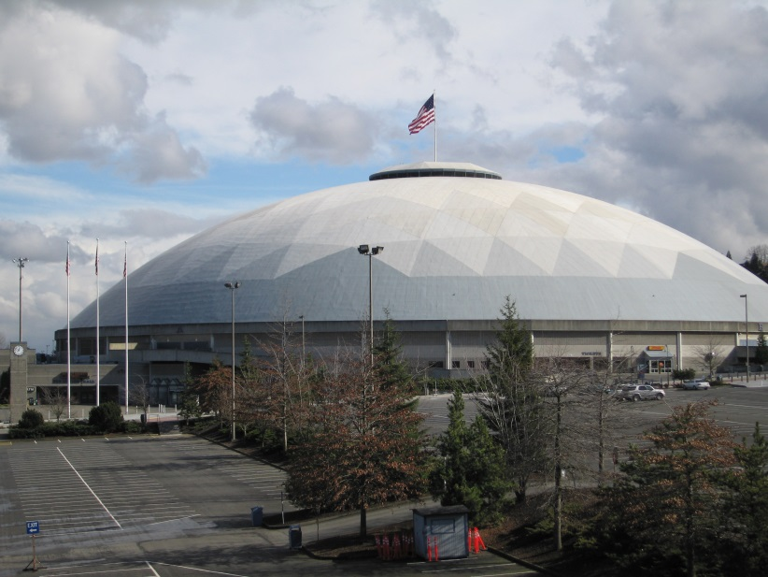
GEODESIC DOME
Commercial Examples
Deitrich Activity Center Walla Walla, 1977
Building Milton, c.1975
Tacoma Dome Tacoma, 1981-83
Cathedralite Office Tacoma, 1978

