Slide 1
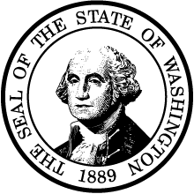
Built Environment Summit: Creative Mitigation Recap

Slide 2
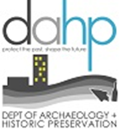
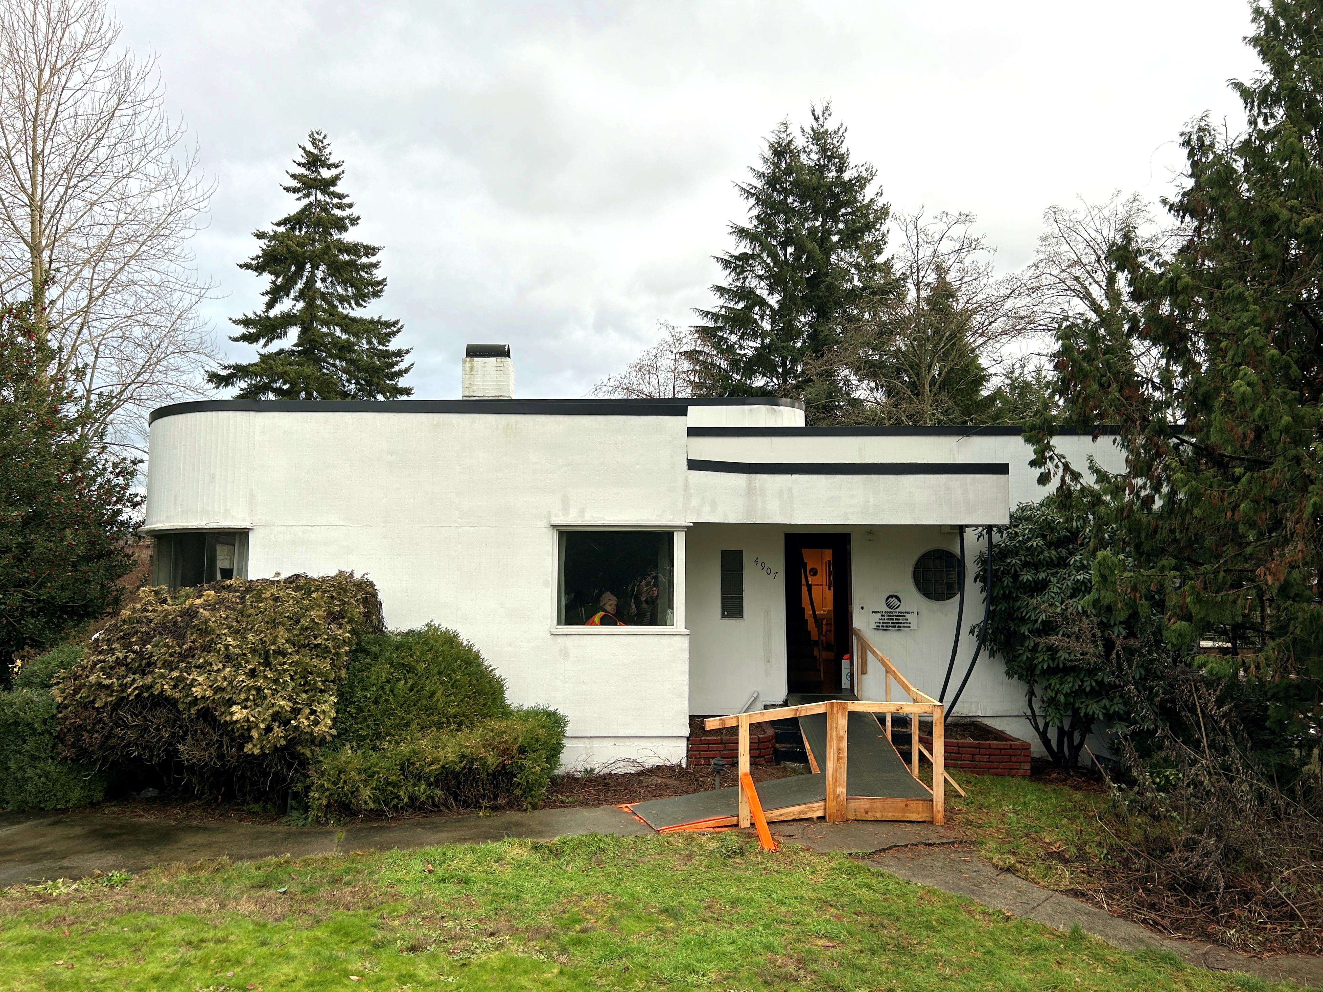
What is mitigation?
Mitigation is an important product of the regulatory consultation process
When it is not possible to avoid or minimize adverse effects/impacts, mitigation is required
When required through DAHP consultation, we will lay out the mitigation plan in an MOU/MOA

Slide 3
DAHP MOUs/MOAs in Numbers

Slide 4
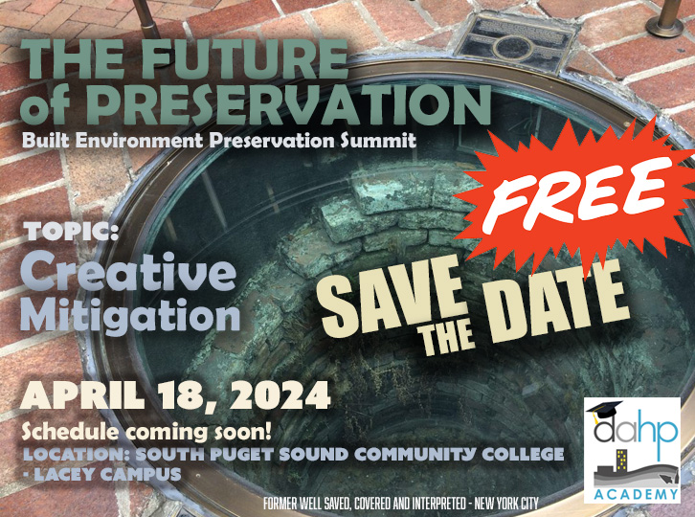
Notes:
Explain the why of the conference

Slide 5
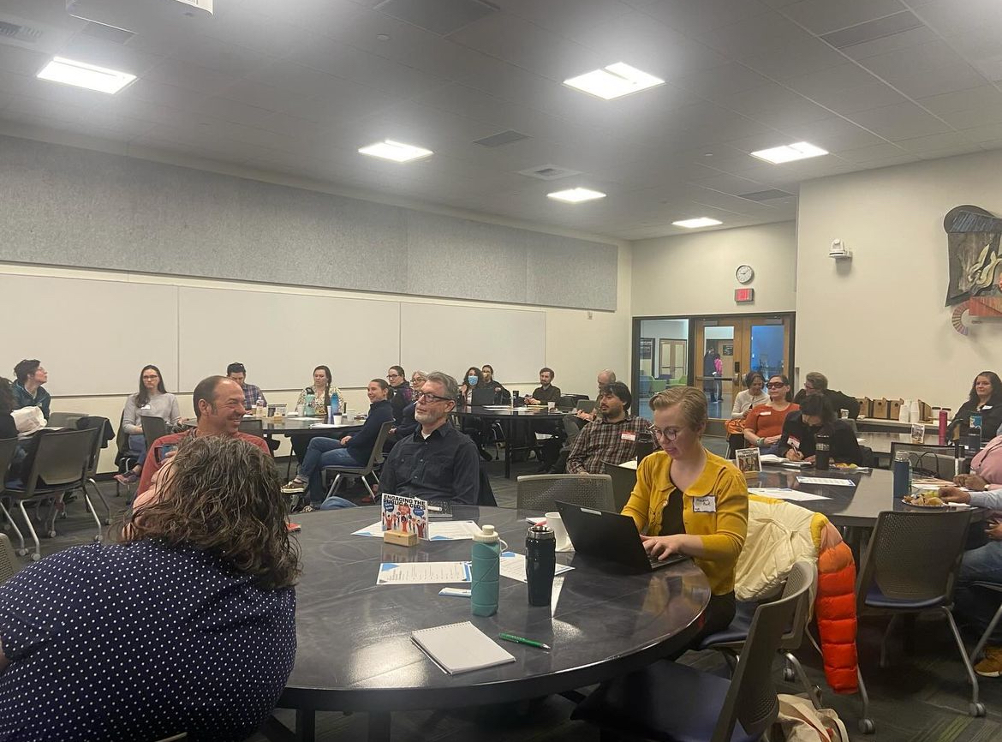
What was discussed?
Case Studies:
WSDOT
BPA
ODOT
Mitigation Speed Dating
Embodied carbon reports
3D Models
HABS/HAER/HALS
Storytelling through oral history
Website technology/story maps
Deconstruction/salvage
Engaging the public/CLGs in mitigation ideas and implementation

Slide 6
DAHP BE Mitigation Standards
Notes:
- we will be focusing mostly on the built environment, however many of these practices work for archaeology as well

Slide 7
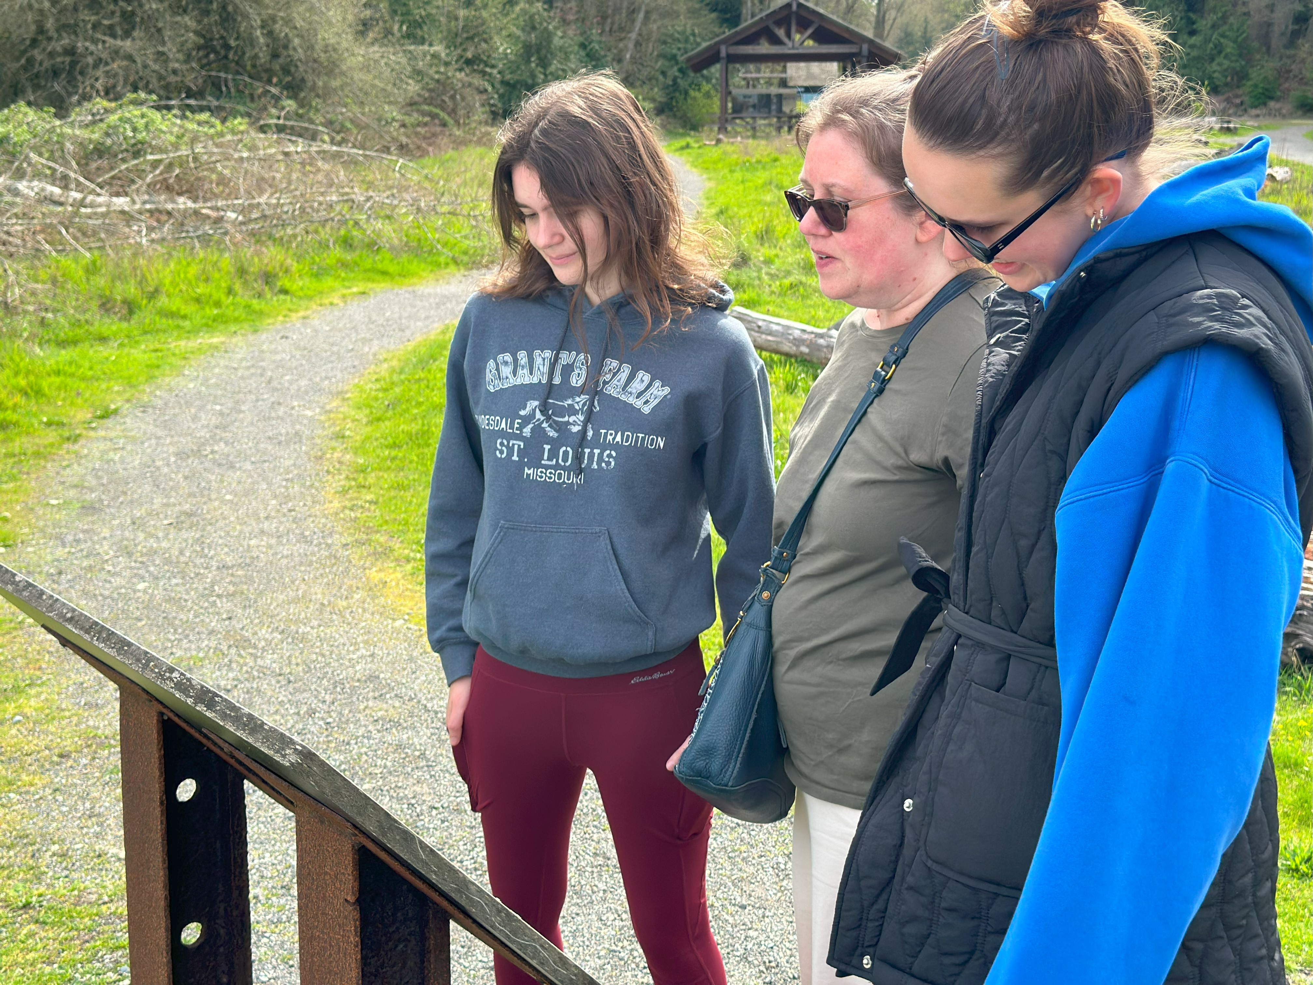
What is creative mitigation?
More engaged with stakeholders
Listening to stakeholders!
Can help lead to broader public involvement, increased appreciation of the past, and ultimately, to greater public pursuit of historic preservation
Looking beyond the ‘usual’ forms of mitigation
Notes:
- Should be and is expected to be standard practice for mitigating adverse effects/impacts at DAHP
- Not meant to be an easy one and done. Thought and time needs to go into mitigating effect
Woodard Bay

Slide 8
Mitigation Plan Considerations
Consider the significance of the affected property
Consider the needs of all parties. What partnerships are available? Who are the stakeholders?
Consider the public benefit
Consider mitigation that enhances knowledge and protection of resources
Consider cost
Notes:
Consider the significance of the affected property.
- somehow relate mitigation to the significance of the property that is being adversely affected
- areas of significance, integrity, qualifying characteristics, and boundaries
- compare the importance of one historic property relative to other properties of its type
- properties that have greater levels of significance generally warrant greater levels of mitigation (National Historic Landmarks, national level of significance, or few remaining examples of a historic property type)
Consider the needs of all parties.
- primary focus of consultation should be on meeting the needs of those consulting parties who ascribe importance or value to a property (tribes, CLGs, main street associations, historical societies)
Consider the public benefit.
- preservation is a public interest
- mitigation should provide a public benefit to the community in which the resource is located
Consider mitigation that enhances knowledge and protection of resources.
- mitigation that enhances the knowledge of and/or protection of similar property types.
- rather than/or in addition to documenting a building that is to be removed, consider historic contexts, HPMPs, etc.
- could also involve the development of educational programs or the preservation of resources outside of a project area.
Consider cost.
- cost of mitigation should be proportionate to the property’s significance and integrity and the scale of the effects of the project

Slide 9
DAHP’s Three-Pronged Approach
1. Documentation
2. Public Education/Interpretation
3. Continued Physical Preservation

Slide 10
1. Documentation
DAHP Level II Documentation or HABS/HAER/HALS
Multiple Property Documentation
Additional inventory work
Embodied Carbon Report
Biographies
National Register Nominations
Historic Structure Report
Resource/Typology Guidebooks
Historic Context Development

Slide 11
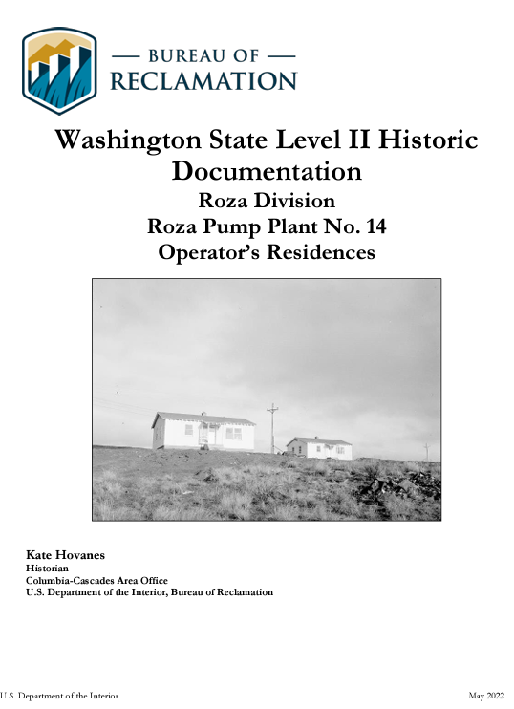
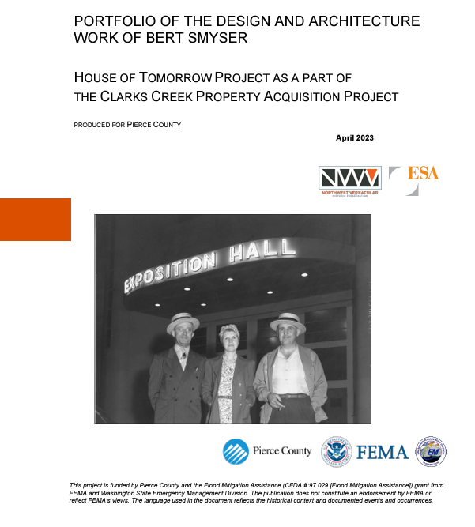
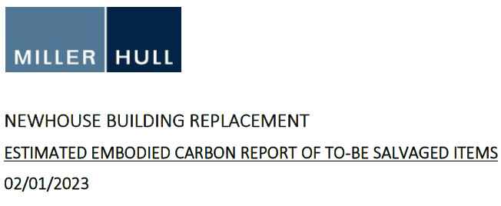

Slide 12
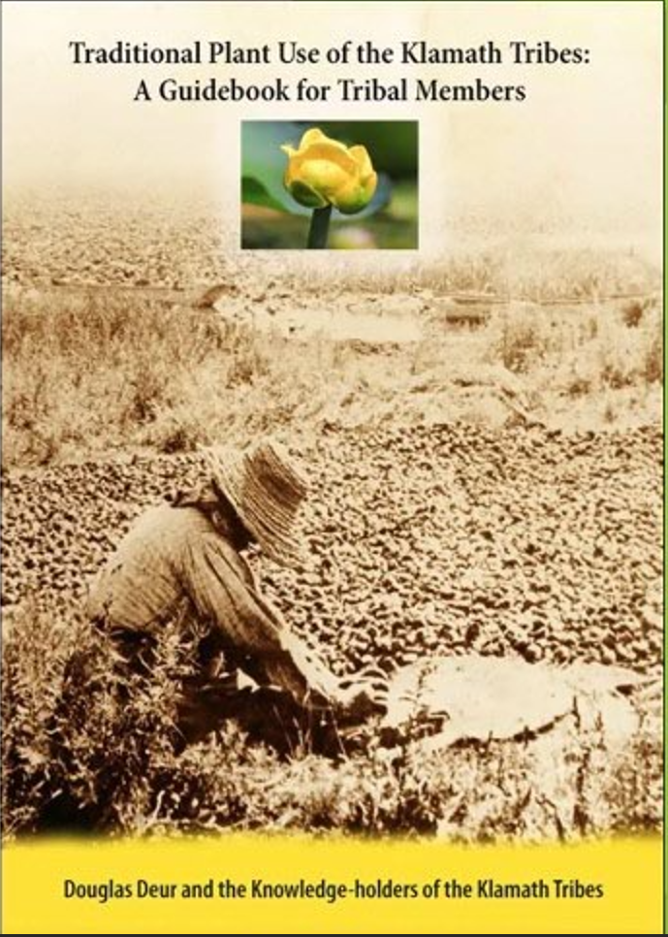
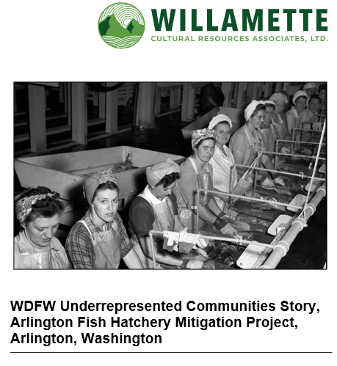

Slide 13
2. Education/ Interpretation
Museum exhibits
HistoryLink essays
Lecture series
Documentaries/ Short Videos
Integration of history-inspired art/salvaged items
Coffee table book
Training/workshops
School curriculum
Walking tours/site tours
Internship programs
Website development
Interpretive signage
GIS story map

Slide 14
Notes:
PORT OF LONGVIEW BERTH 4 GRAIN ELEVATOR AND SILO COMPLEX

Slide 15
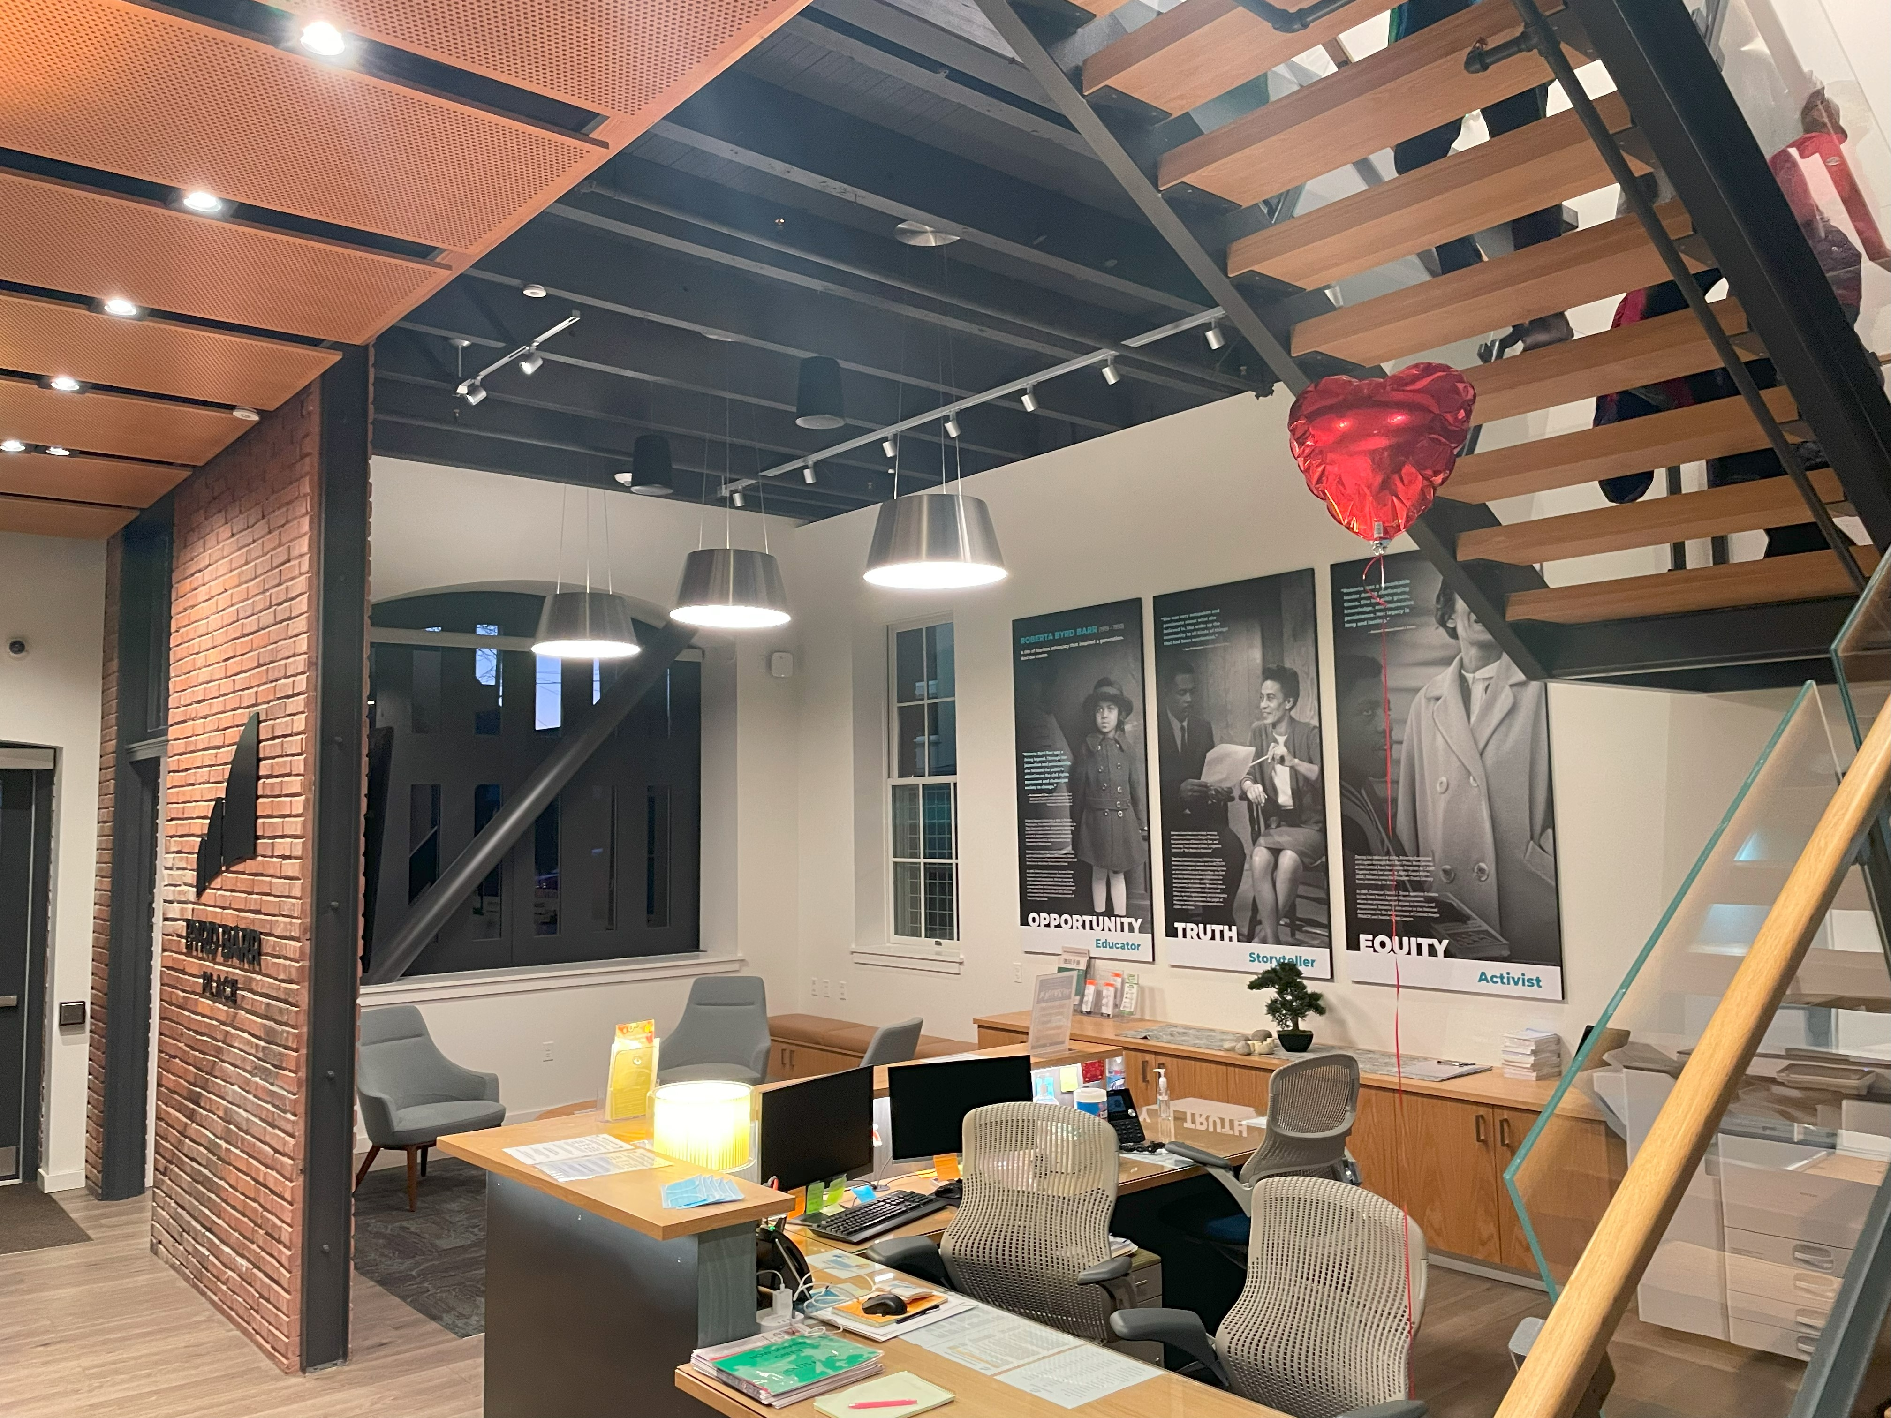
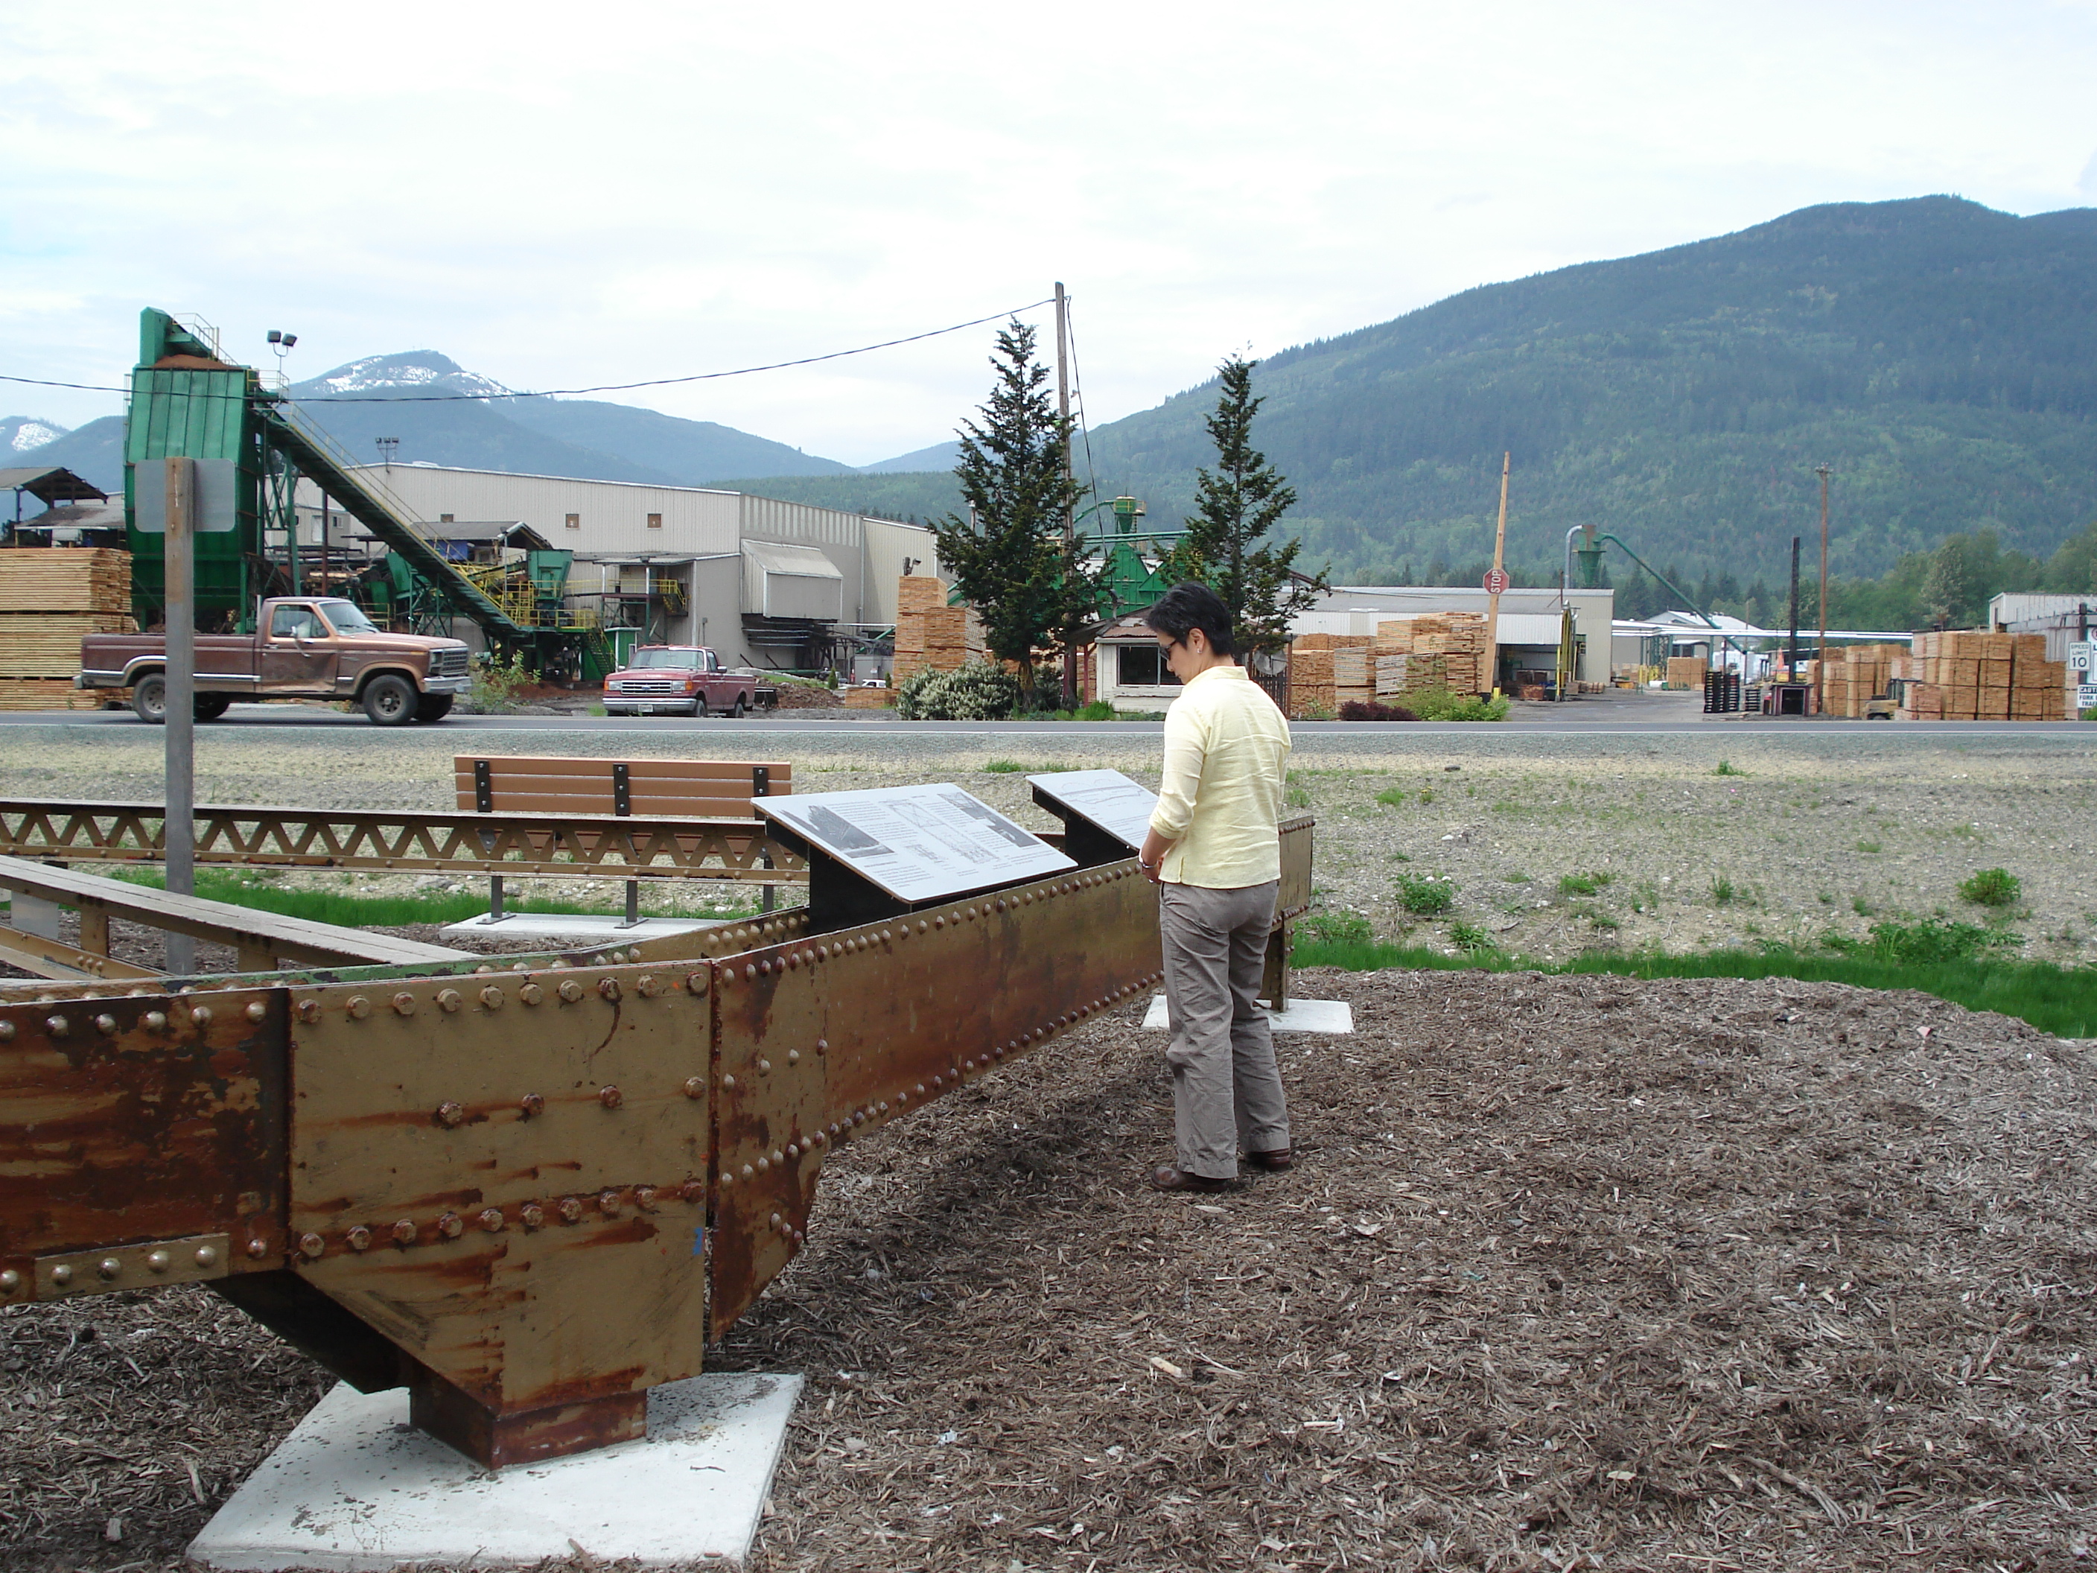
Notes:
Salk River Bridge replacement

Slide 16
3. Continued Physical Preservation
Additional consultation to ensure compatible replacement buildings/structures
Review of future phases of projects, even if not under regulatory review
Support for preservation non-profit organizations (Facade improvement grant, Valerie Sivinski Fund)
Moving, deconstructing, or salvaging resources
Preservation covenants
Support for WISAARD development and enhancement

Slide 17
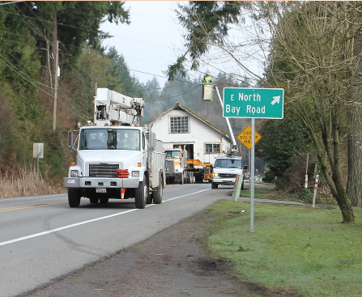
Notes:
Allyn Sargent Oyster House move
Freeway Park Renovation review
Second Use salvaging pieces of Western State Hospital

Slide 18
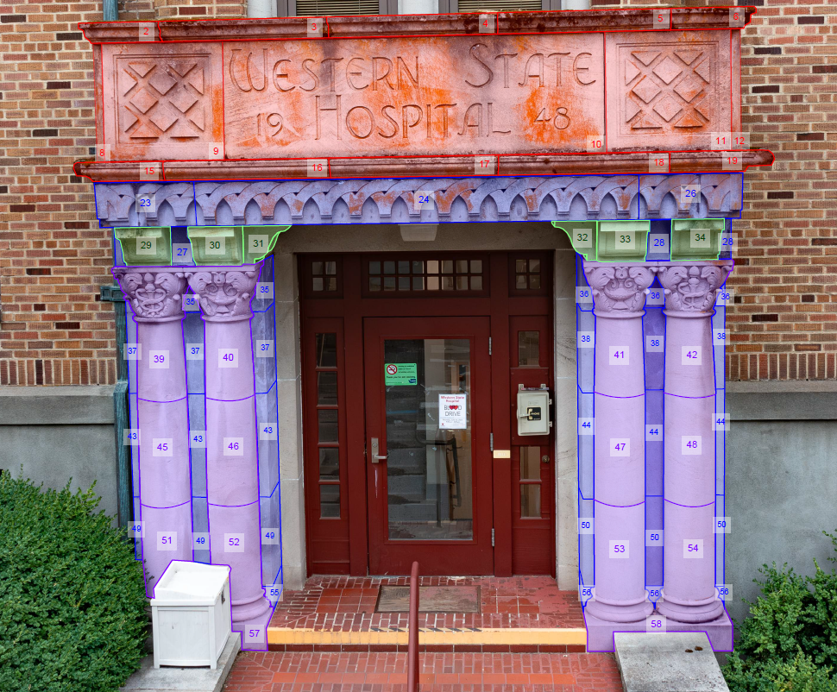
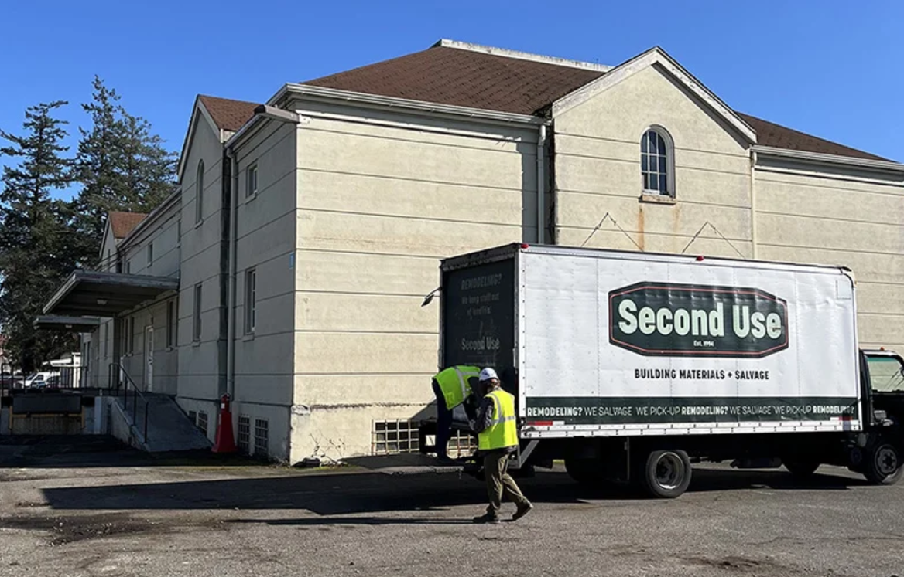
Notes:
Western State Hospital portico and salvage

