Slide 1
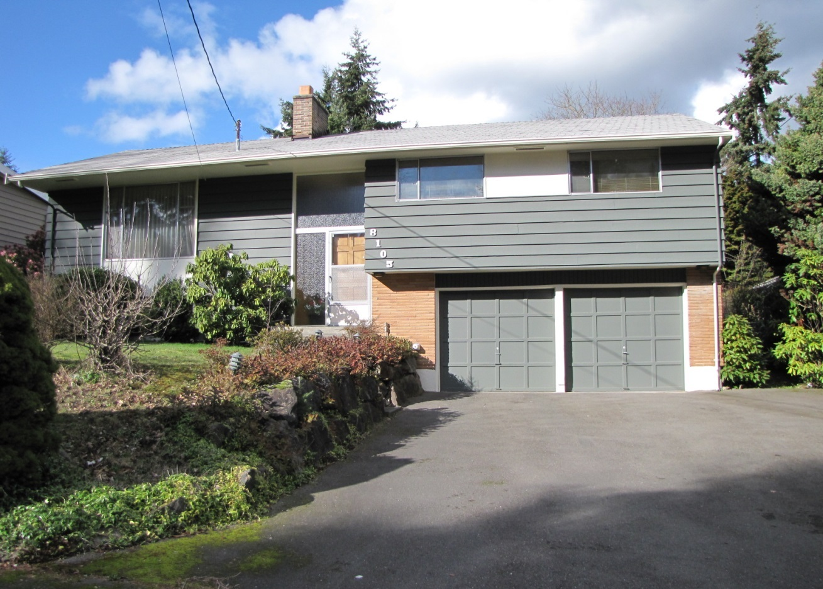
SPLIT ENTRY
1950-1990
Front door leads to two-story landing halfway between two floors, most often centrally located
Various types of roof forms found including front and side-facing gables or combination thereof
Upper level contains working and sleeping spaces, lower level has garage and living area
Often, upper level has projecting facade
Aluminum sliding glass windows are common
Raised basement with windows near grade level
Applied ornamentation varies with high use of Colonial elements
House Lynwood, c.1970
Concrete Foundation

Slide 2
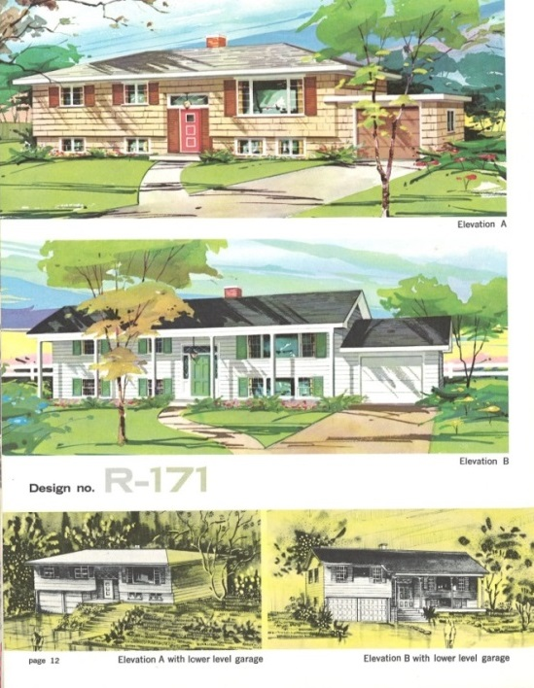
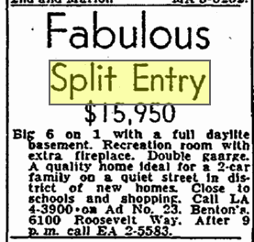
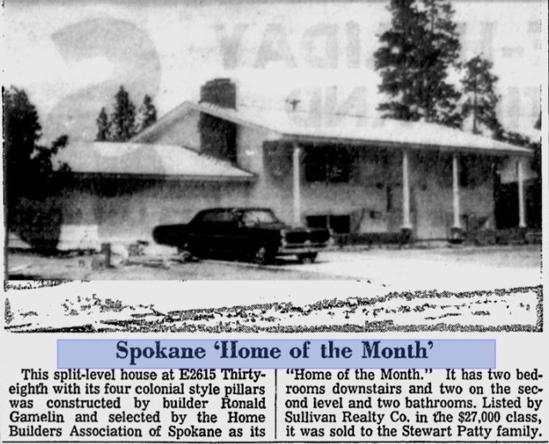
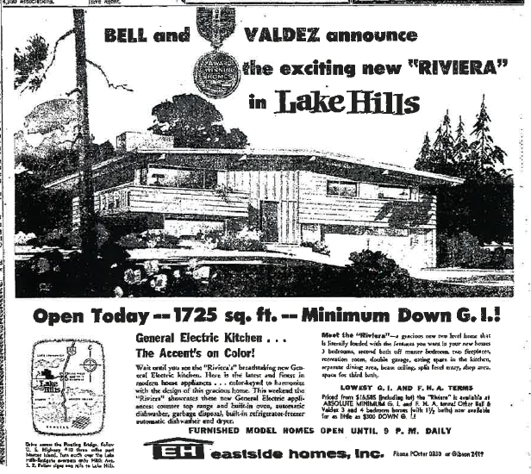
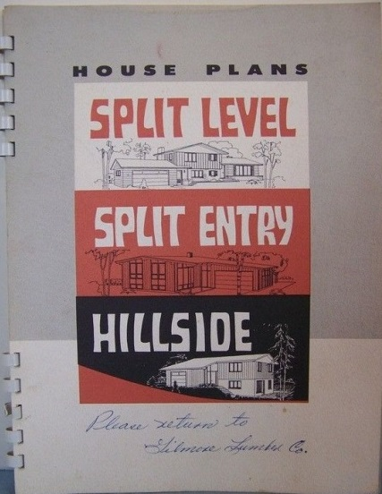
SPLIT ENTRY
History
Plan Book 1962
Seattle Times June 13, 1958
Spokesman Review June 30, 1968
Plan Book 1968
Seattle Times March 31, 1957
Seattle Times October 22, 1950

Slide 3
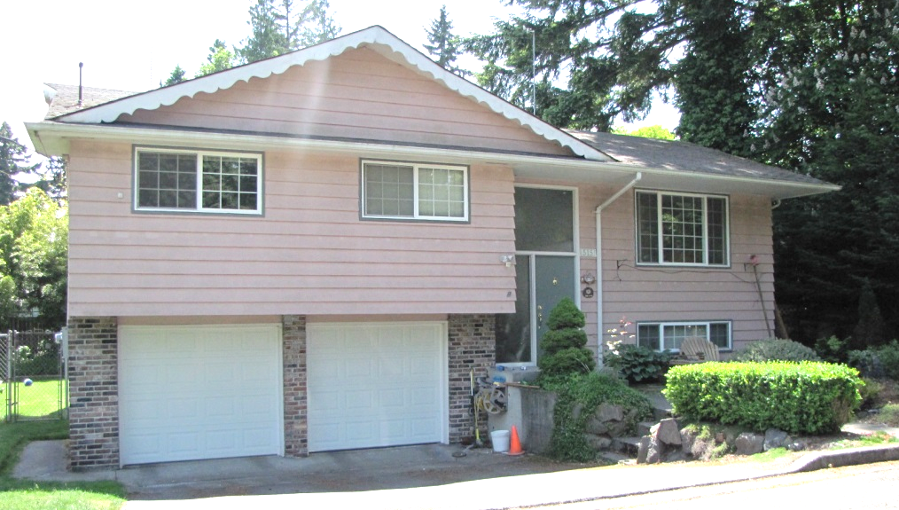
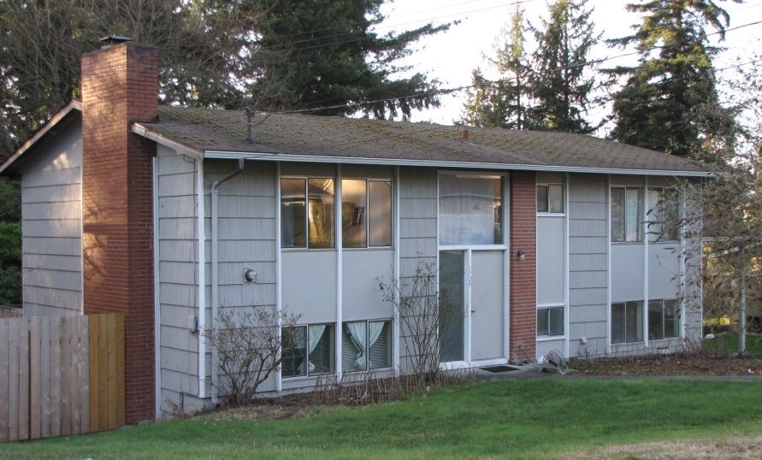
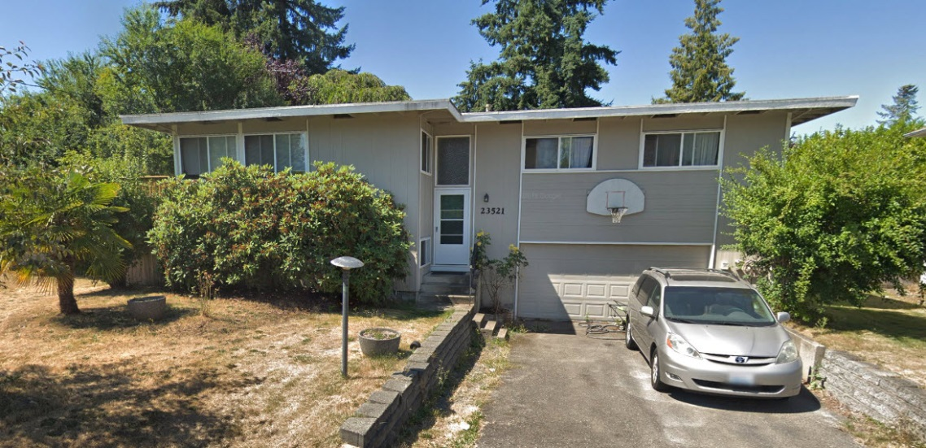
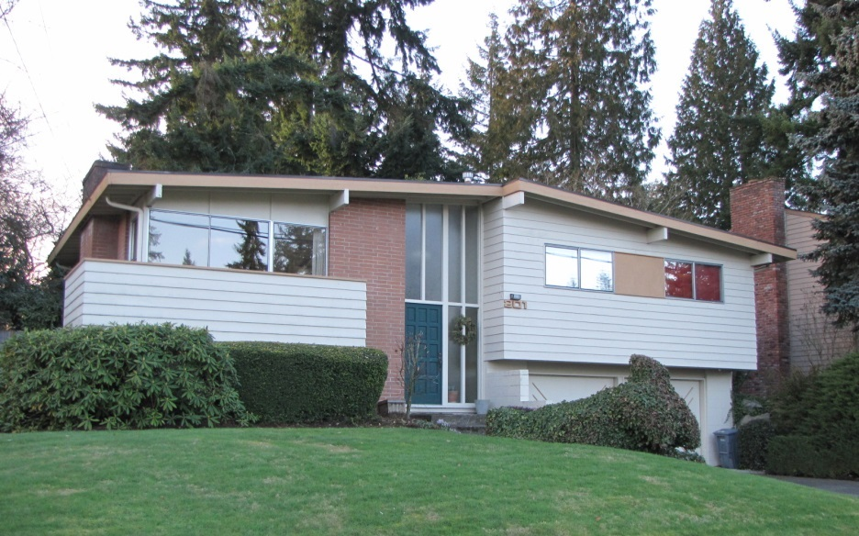
SPLIT ENTRY
Residential Examples
House Bellevue, c.1968
House Lynwood, c.1972
House Kent, c.1970
“Riviera” Model Home Bellevue, c.1958

Slide 4
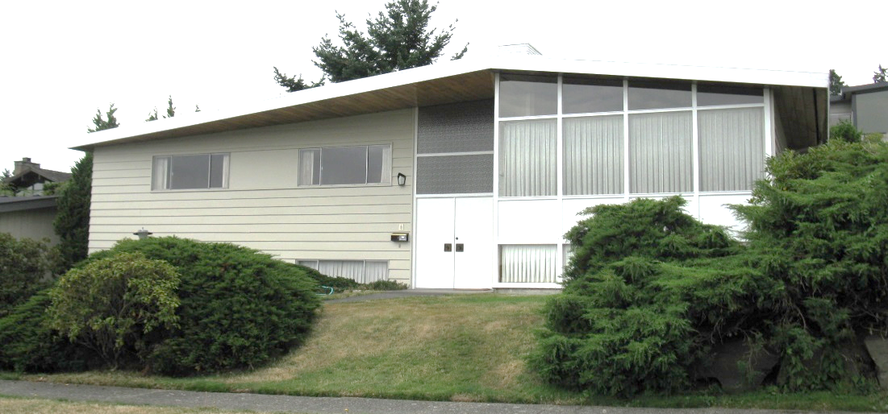
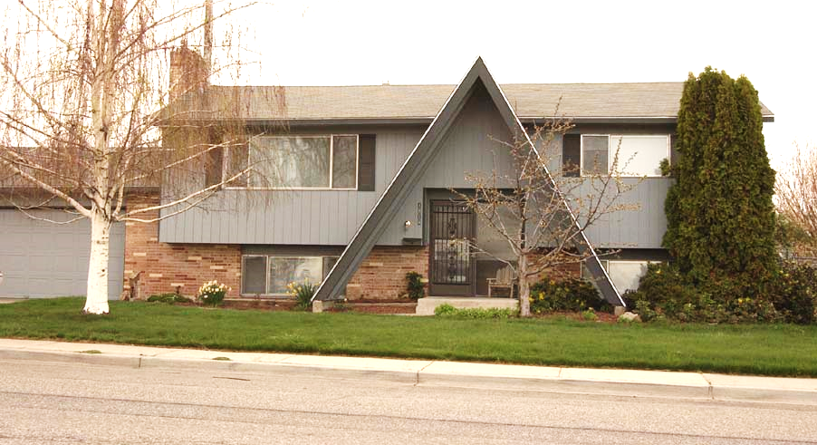
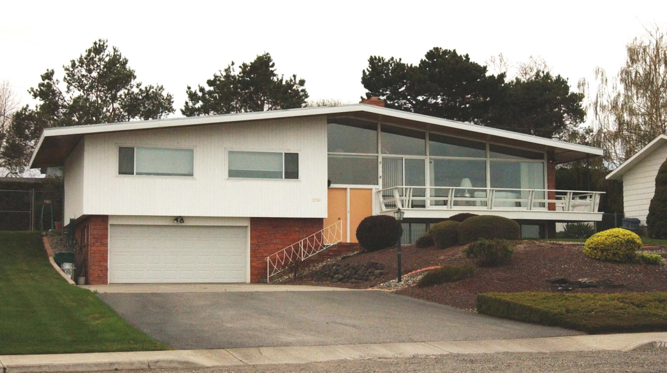
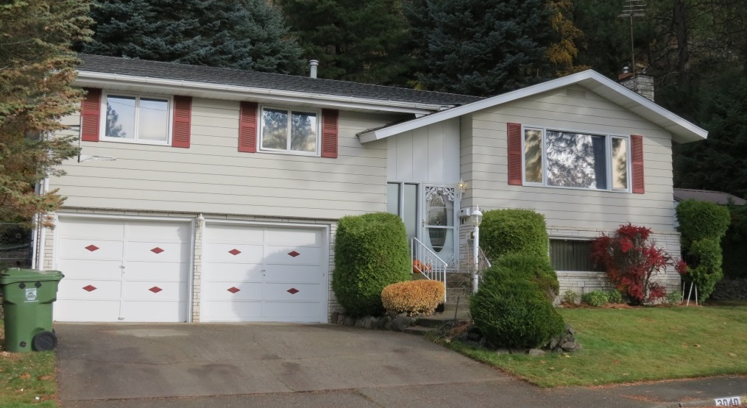
SPLIT ENTRY
Residential Examples
House Seattle, c.1968
House Richland, c.1975
House Spokane, c.1975
House Kennewick, c.1965

Slide 5
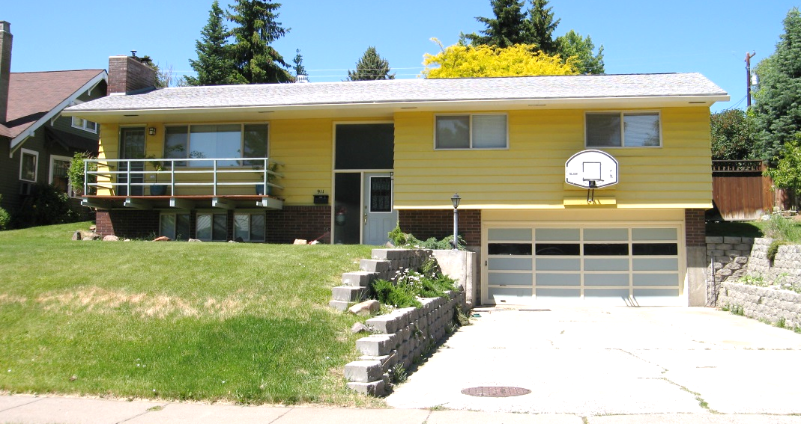
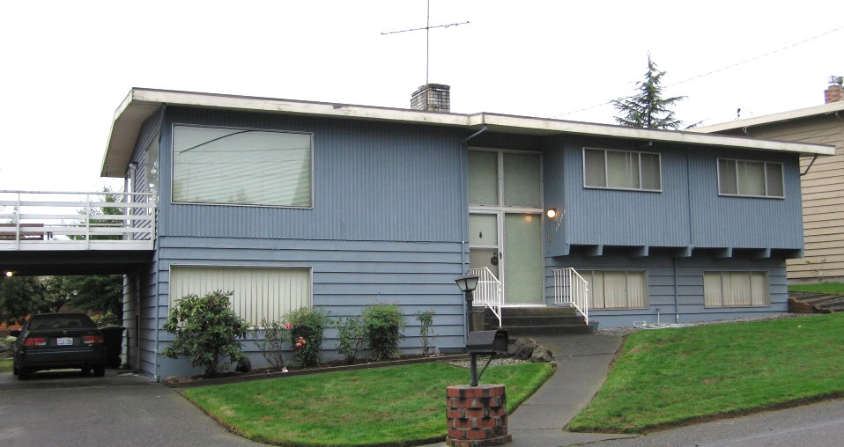
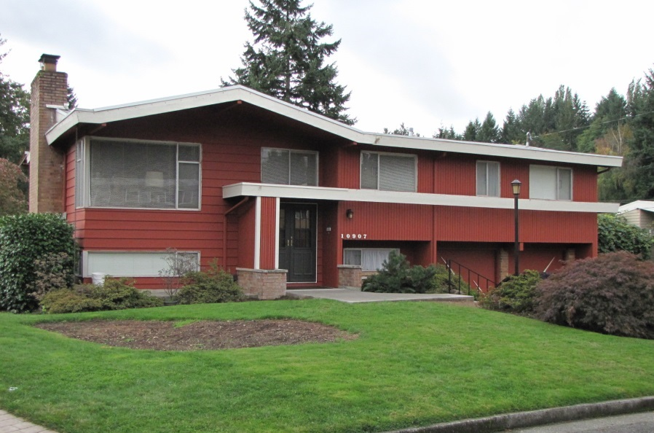
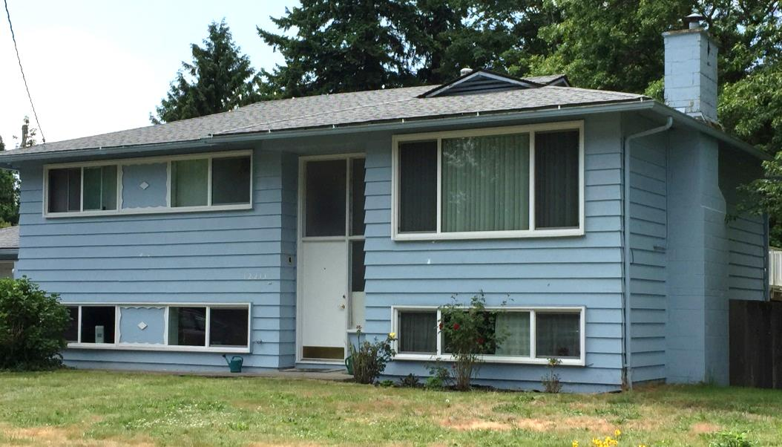
SPLIT ENTRY
Residential Examples
House SeaTac, c.1968
House Ellensburg, c.1969
House Bellevue, c.1968
House Kirkland, c.1971

Slide 6
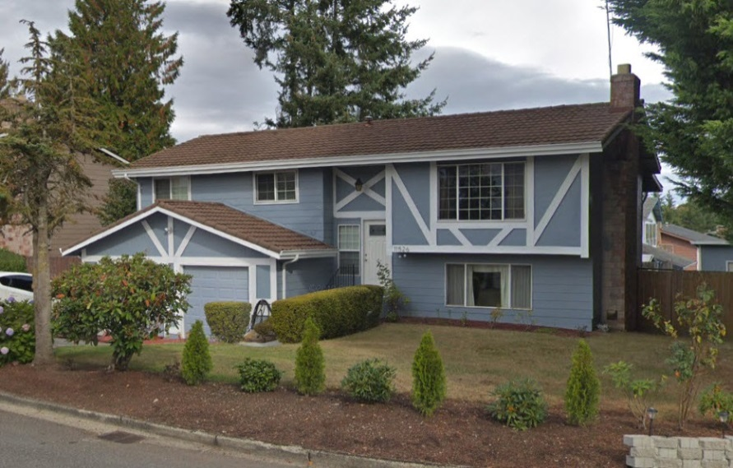
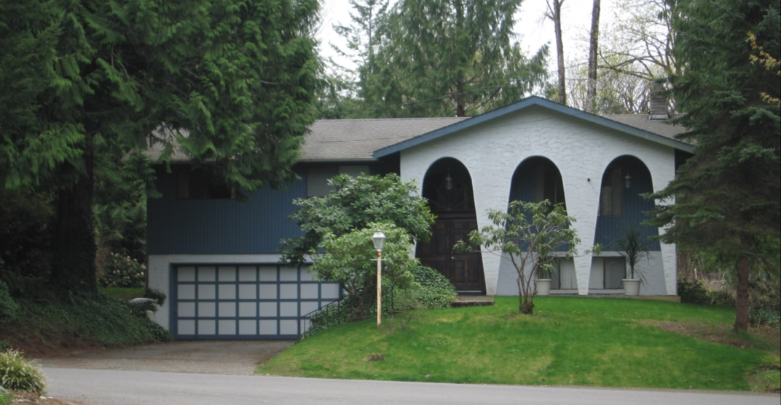
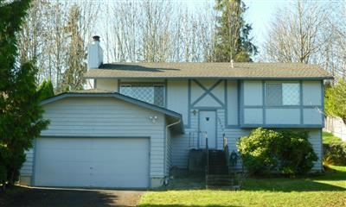
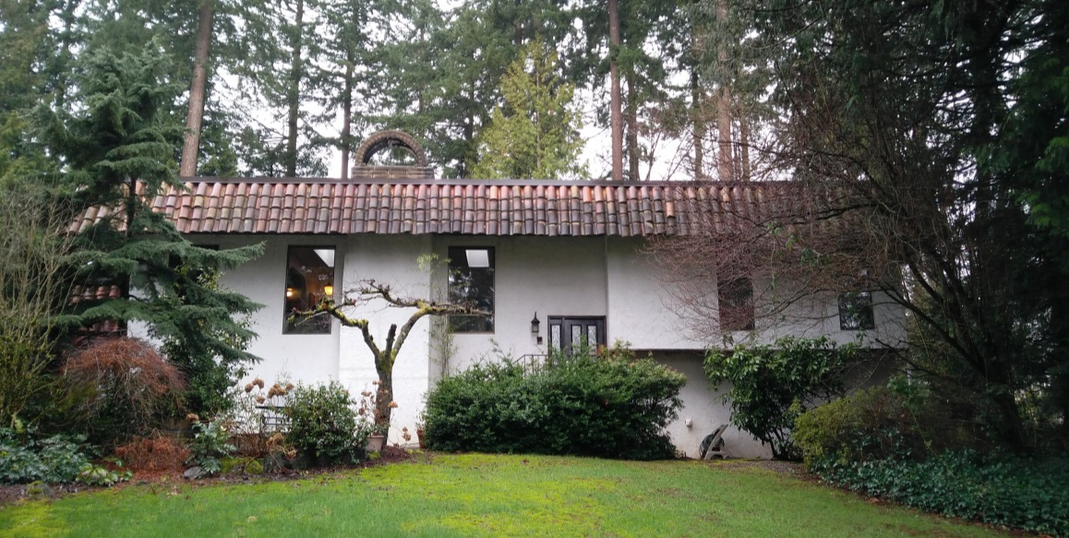
SPLIT ENTRY
Tudor | Spanish Examples
House Kent, c.1969
House Olympia, c.1975
House, Renton, c.1968
House Redmond, c.1973

Slide 7
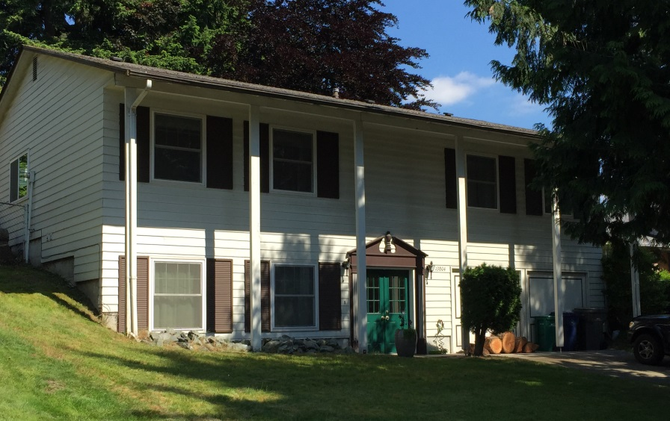
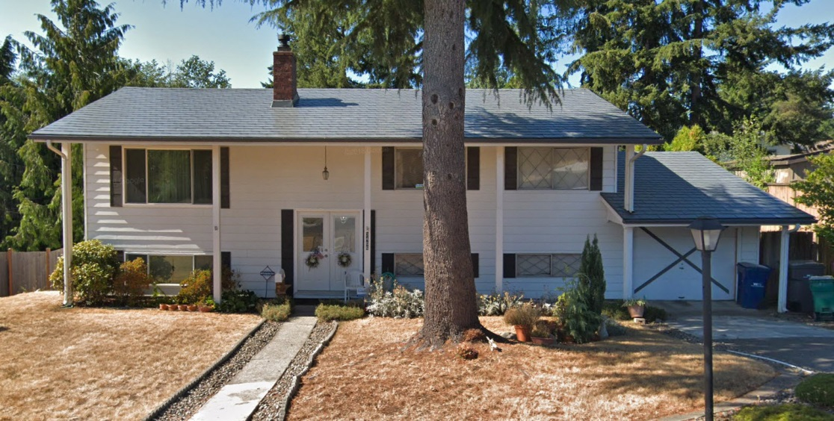
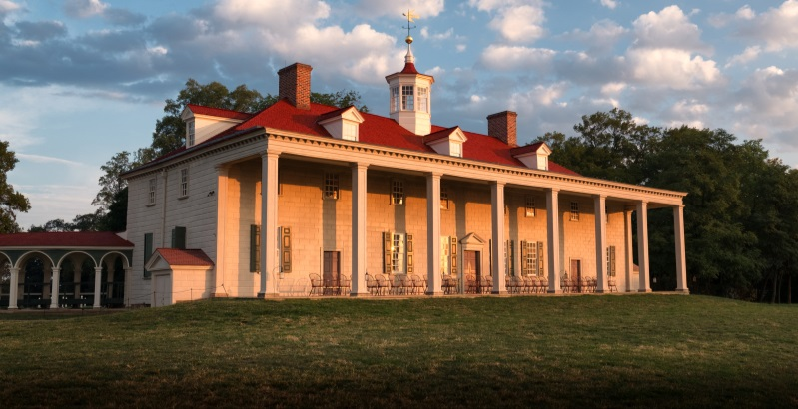
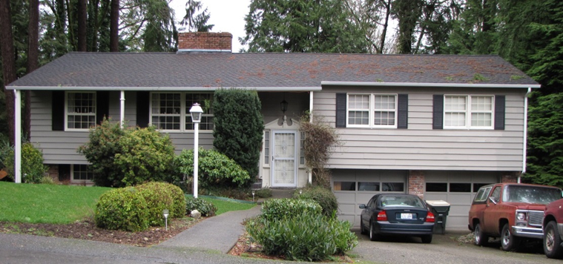
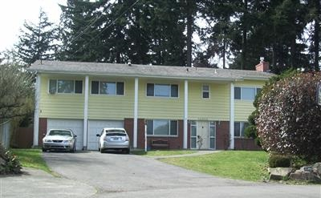
SPLIT ENTRY
Early American Examples
House Kirkland, c.1970
House Federal Way, c.1975
House, Olympia , c.1967
House Shoreline, 1961

